Slide 1


Online Store : Backend
Infrastructure
github.com/NBakaev/hishop
Bakaev Nikita, 13PE
2016

Slide 2
Introduction
Infrastructure
Code
What’s next ?
DEMO
Questions

Slide 3
Components
MongoDB
Docker
Java
Spring
REST
Spring Boot
Travis CI
Ubuntu
Swagger
Travis CI
Notes:
Swagger, heroku paas support... herokupaas
Ci notes : auto deploy release to maven public repo and docker repo
Cimavendocker

Slide 4
...
Maven - Build system
TestNG - Unit, integration tests
Java libs - Jackson, Apache POI...
Github - Git repo and issues
...
Notes:
AWS S3
Digital Ocean

Slide 5
Metrics
90%
Code coverage
> 200
commits
> 40
tasks

Slide 6
Infrastructure

Slide 7

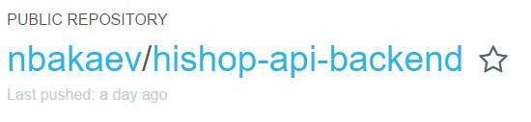
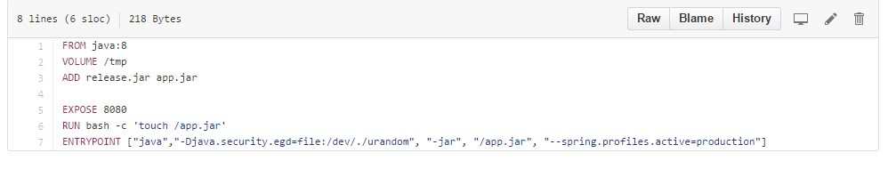
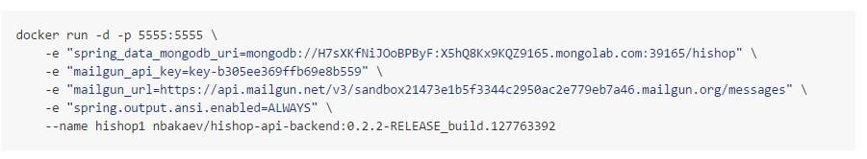

Slide 8

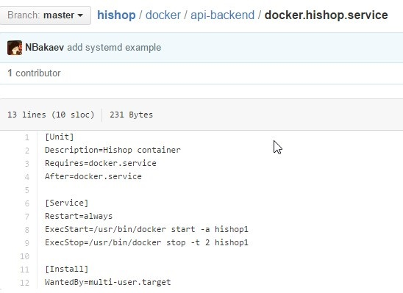
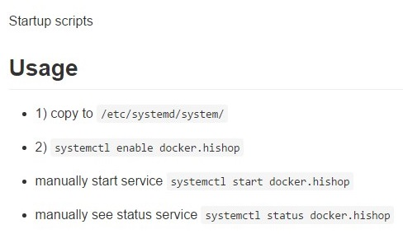

Slide 9
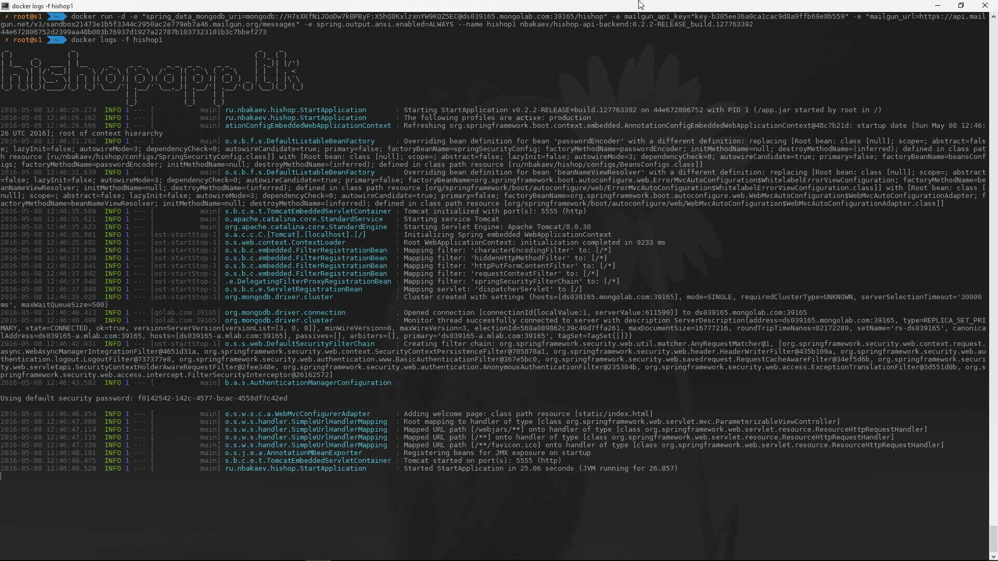

Slide 10
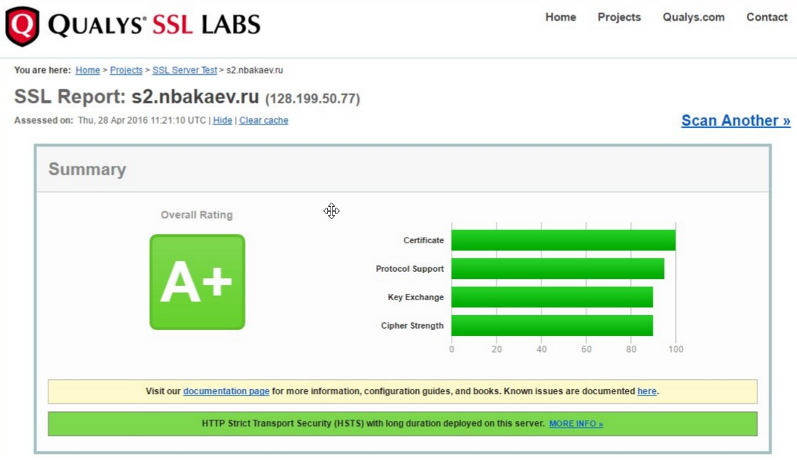

Slide 11
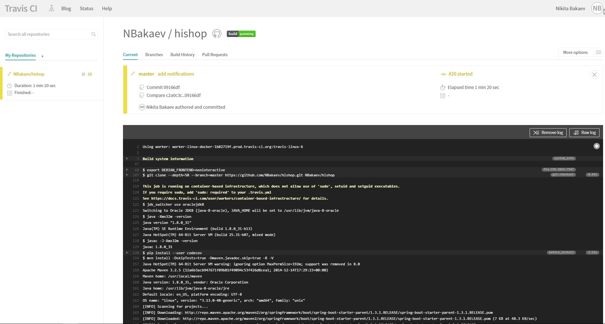

Slide 12
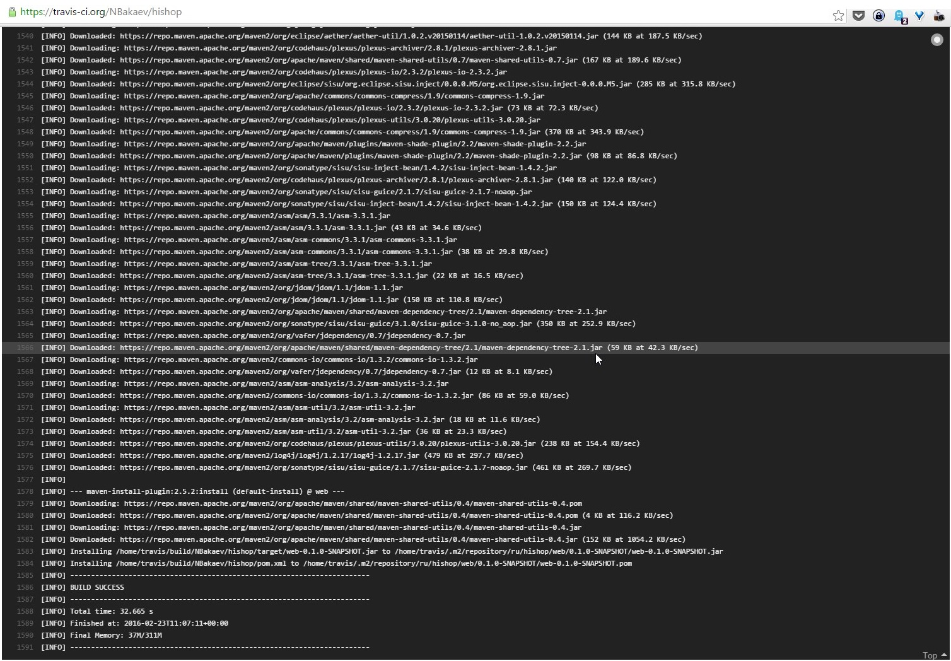

Slide 13
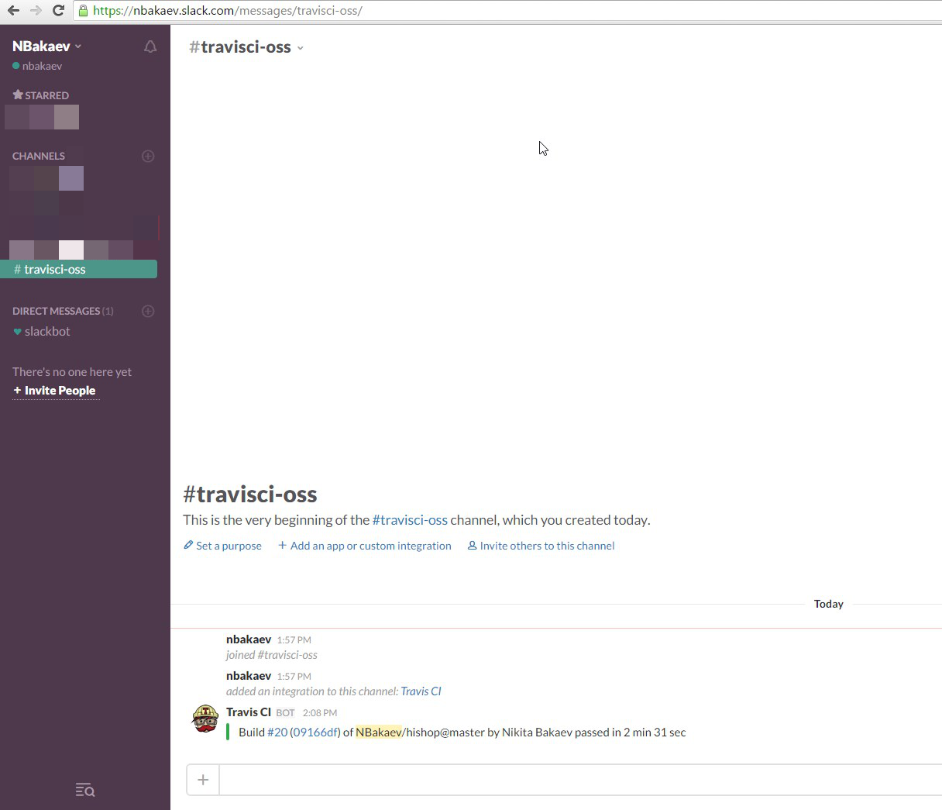
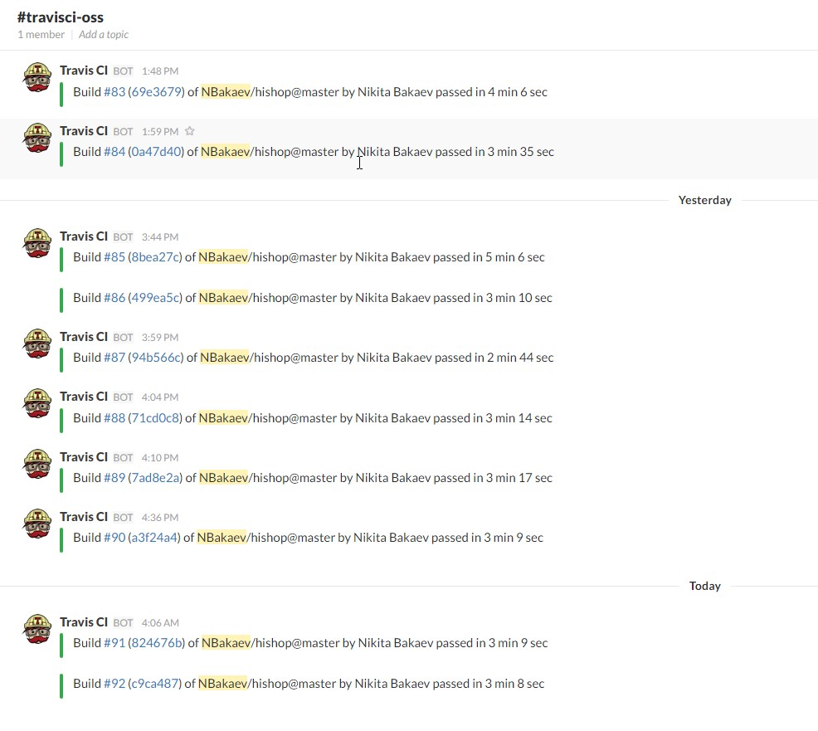
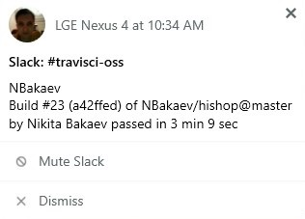
Slack

Slide 14
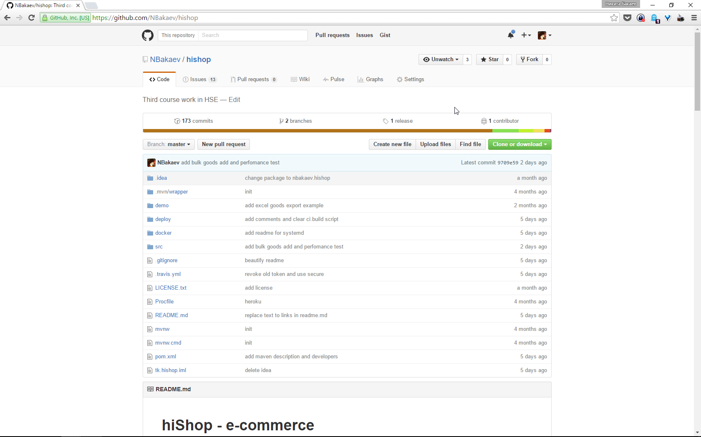

Slide 15
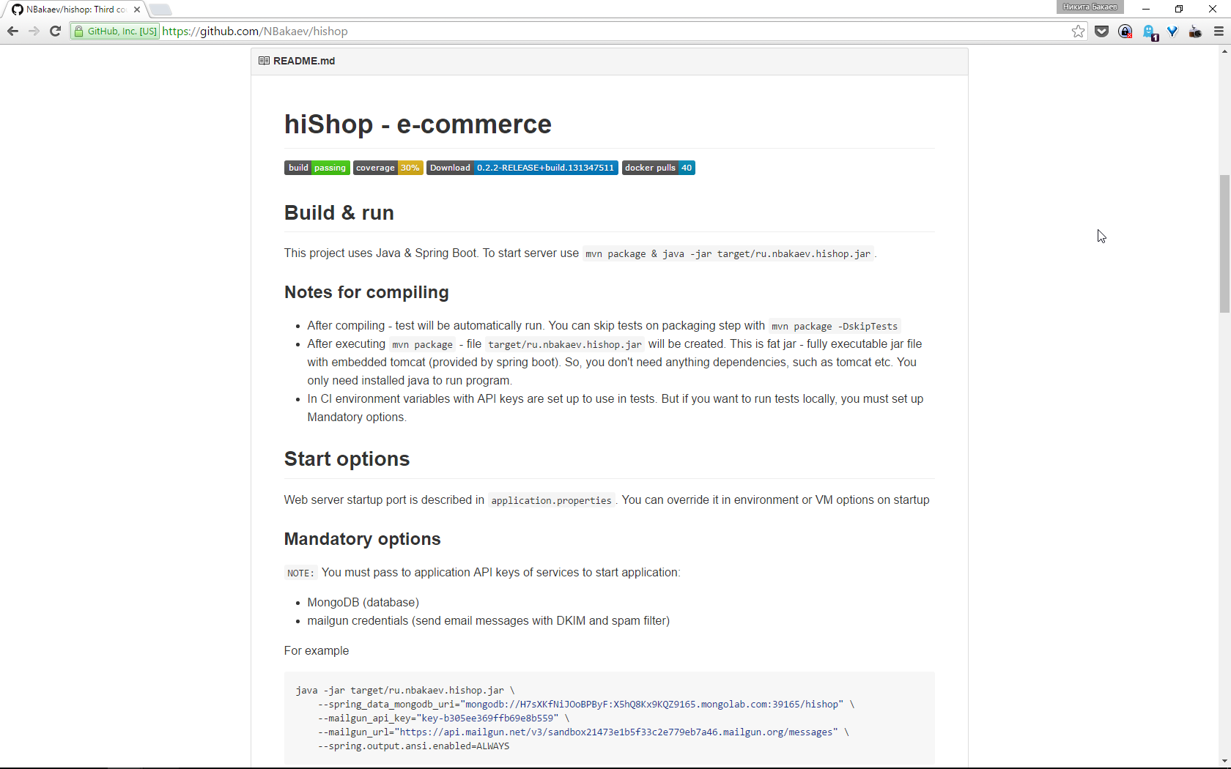

Slide 16
Performance

Slide 17
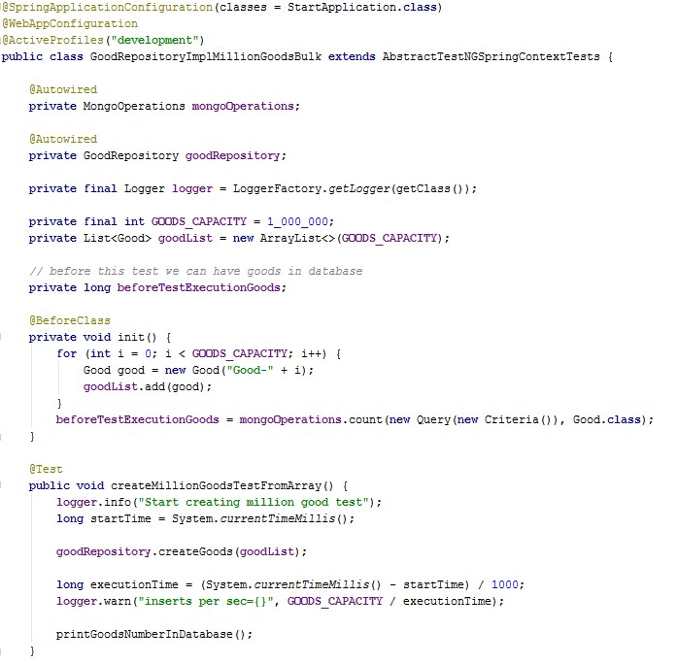
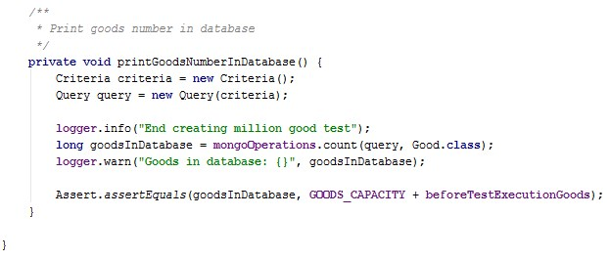

Slide 18
Add goods
1 000 000
inserts
37 037
per/sec
27
sec
Notes:
one thousand

Slide 19
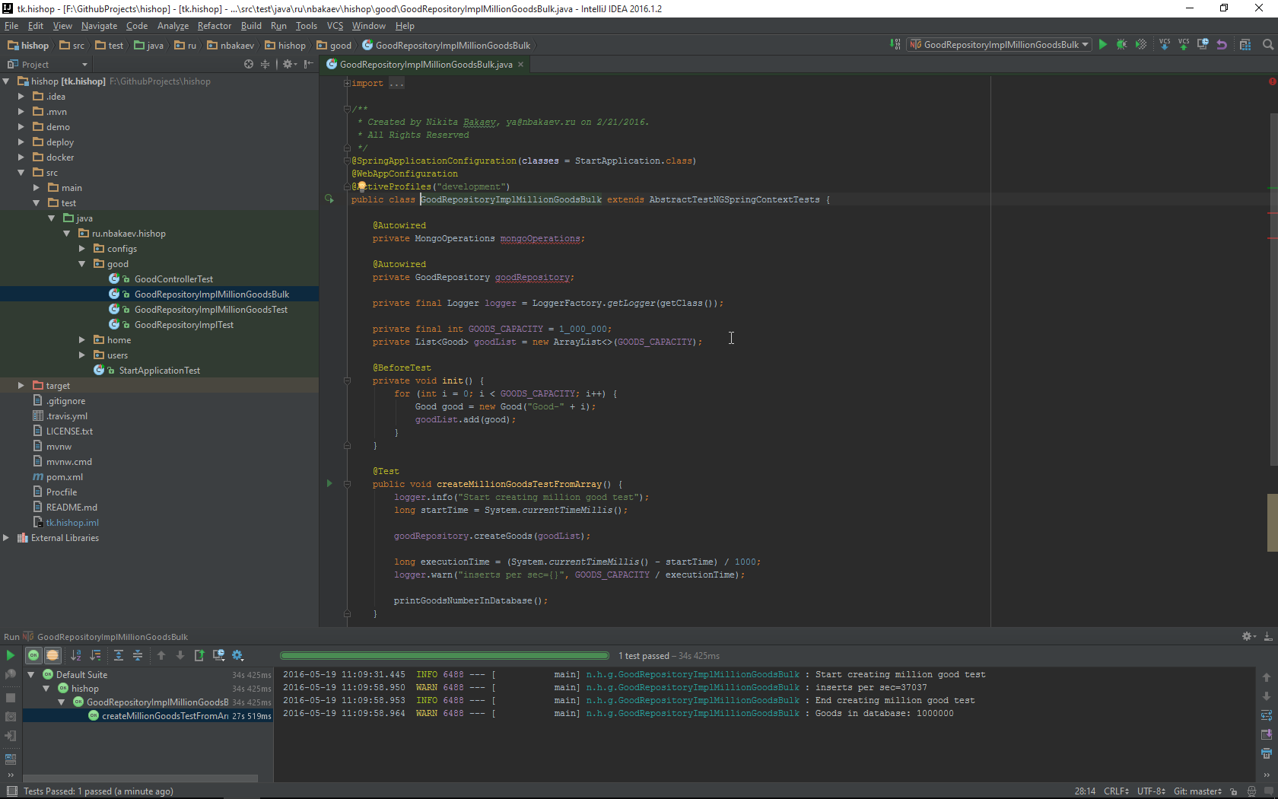

Slide 20
Deeper
in the code

Slide 21
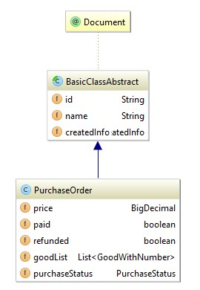
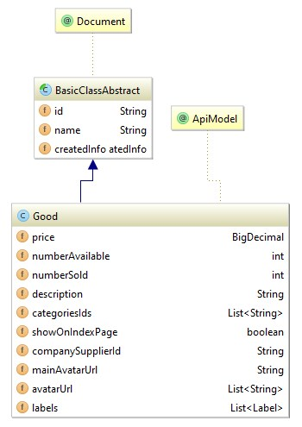
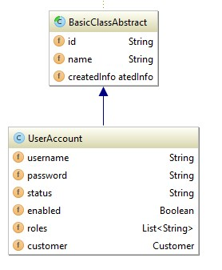
Domain models 1/2
Notes:
AWS S3
Digital Ocean

Slide 22
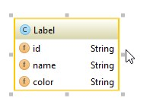
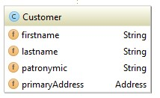
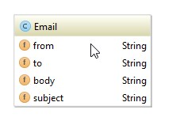
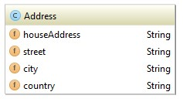
Domain models 2/2
Notes:
AWS S3
Digital Ocean

Slide 23
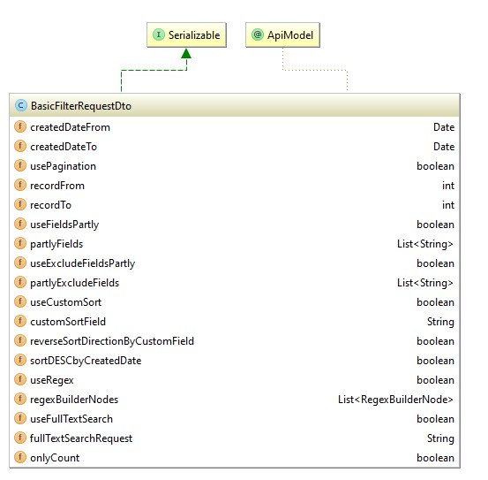
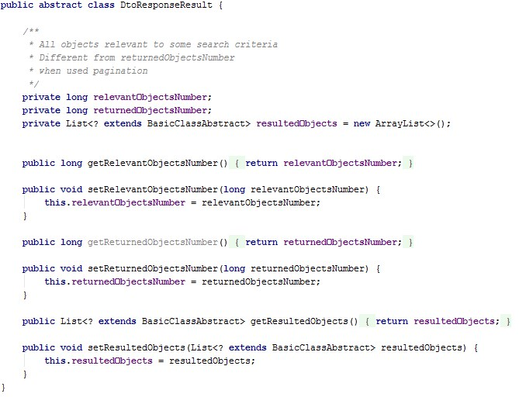
DTO
Notes:
AWS S3
Digital Ocean

Slide 24
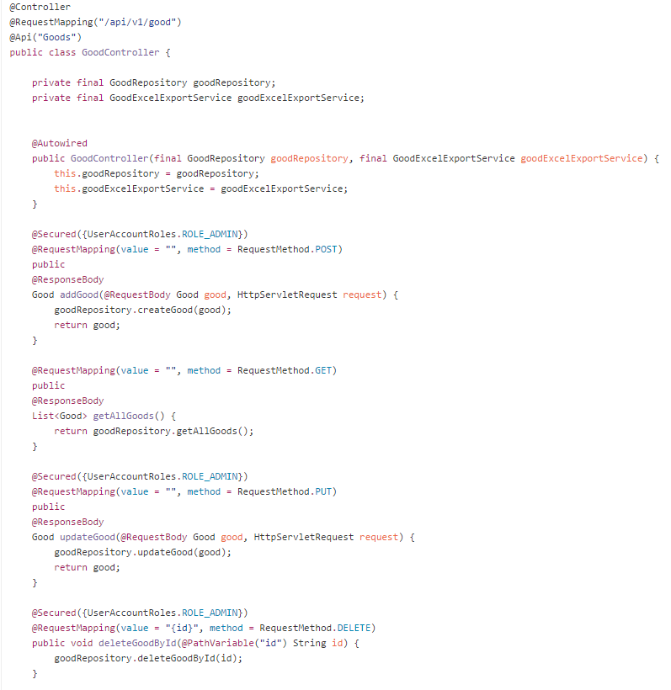
MVC
Notes:
AWS S3
Digital Ocean

Slide 25
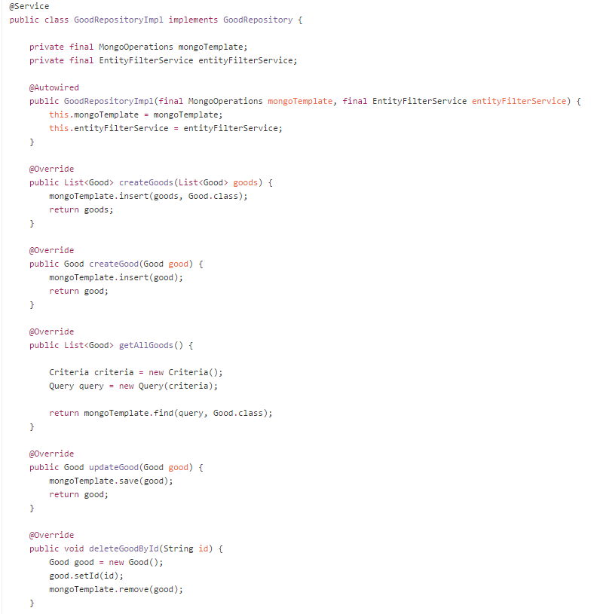
Data layer
Notes:
AWS S3
Digital Ocean

Slide 26
AWS S3

Slide 27
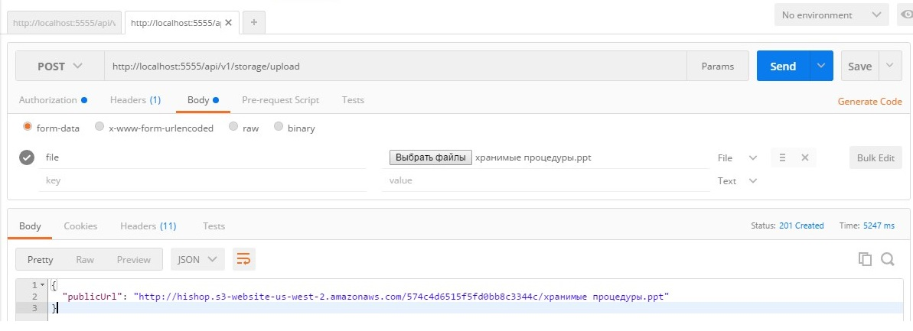
AWS S3: public bucket, CORS
Notes:
AWS S3
Digital Ocean

Slide 28
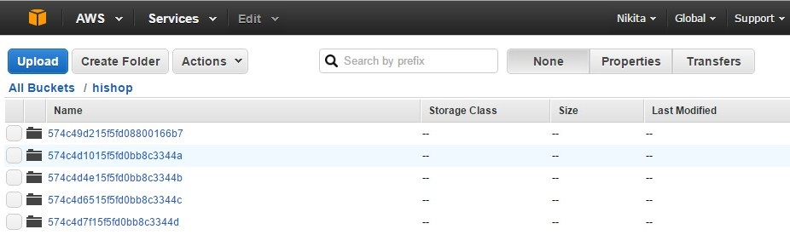
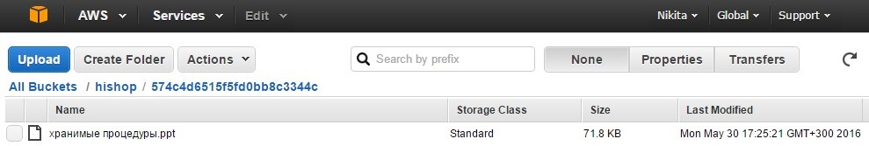
AWS S3: public bucket, CORS
Notes:
AWS S3
Digital Ocean

Slide 29
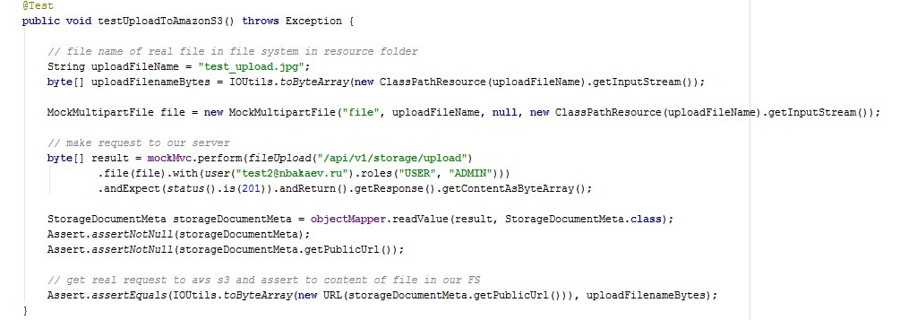
AWS S3: test: read from FS -> upload -> assert
Notes:
AWS S3
Digital Ocean

Slide 30
Excel & Templates

Slide 31
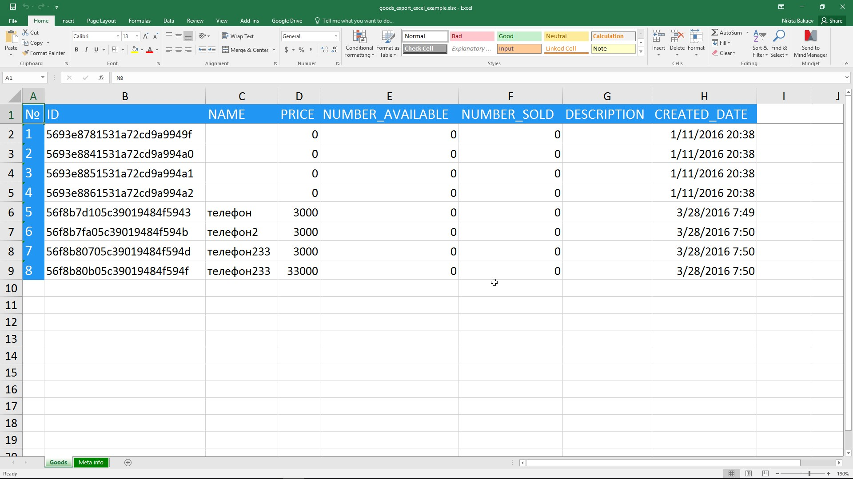
Excel
Notes:
Colors, auto width, fix header

Slide 32
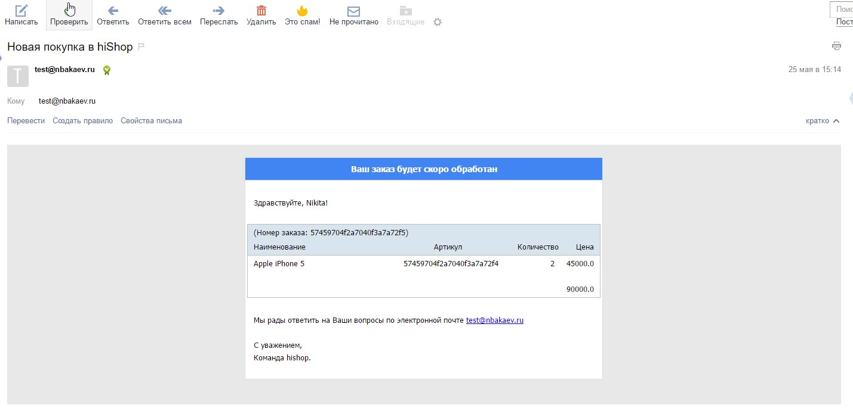

Slide 33
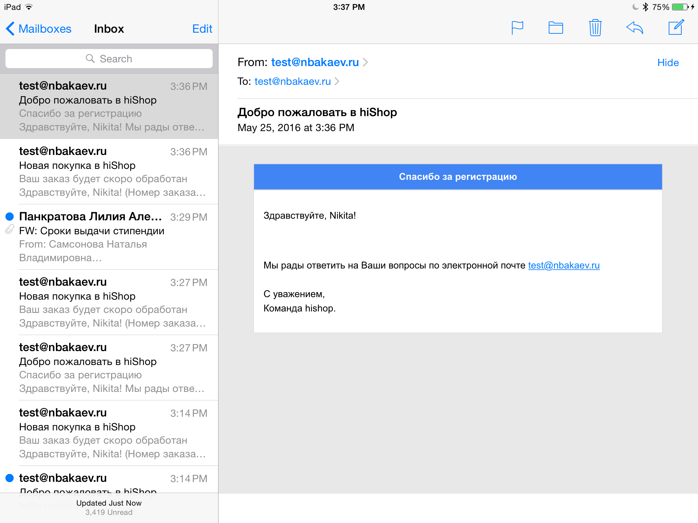
Notes:
Show responsive, support all email clients

Slide 34
What's next?

Slide 35
Backend: high availability cluster, auto scaling, container orchestration (kubernetes)
Database: sharding, replica set
...more features
What's next? 1/4
Notes:
kubernetes, dynamic resource allication, consul, service discovery….

Slide 36
External configuration: consul, recommendation, machine learning for goods
What's next? 2/4
Notes:
vault, zookeeper

Slide 37
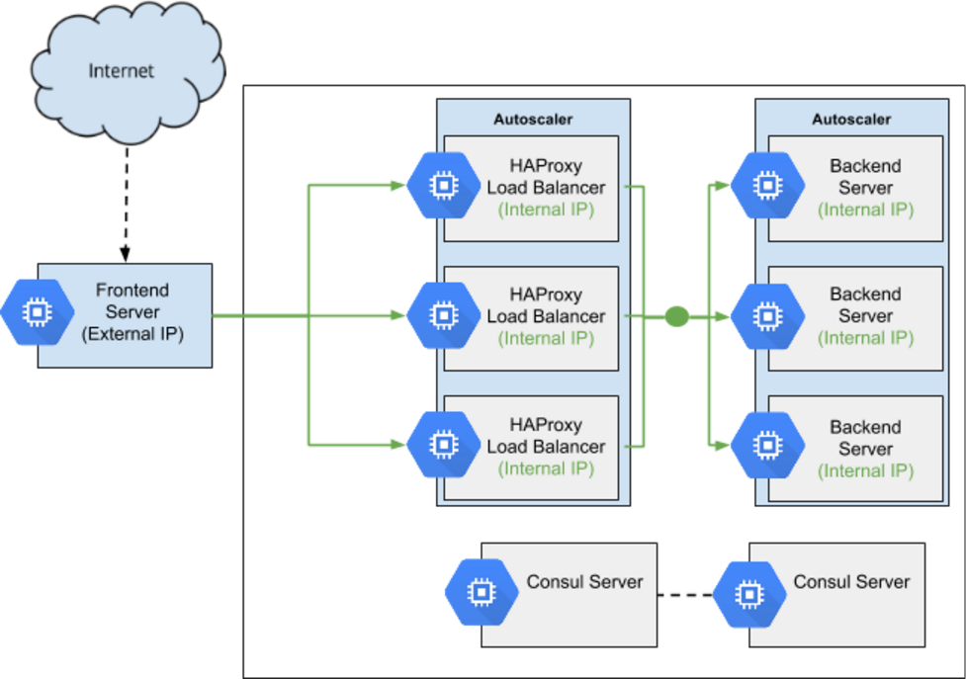
auto scaling, service discovery, load balancing
Notes:
AWS S3
Digital Ocean

Slide 38
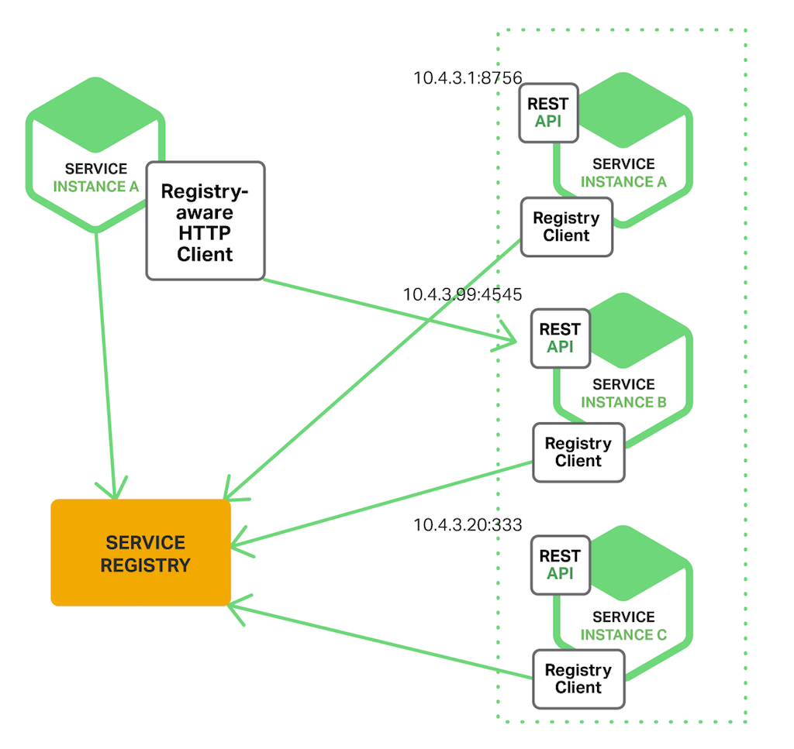
Notes:
AWS S3
Digital Ocean

Slide 39
Purchase -> microservice
with RDBMS ( to have transactions )
i18n / i10n
What's next? 3/4

Slide 40
Templates in html render to .doc/.pdf
Easier
more powerful than Jaspersoft Studio
Custom fields
MongoDB schemaless
full-text search, detailed queries, ranges
...
What's next? 3/4

Slide 41
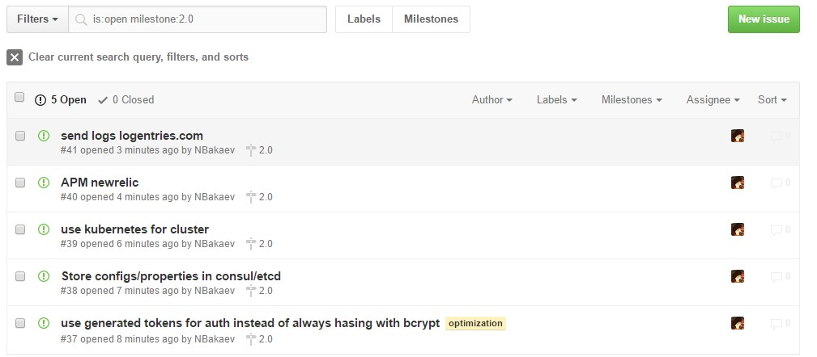
Notes:
AWS S3
Digital Ocean

Slide 42
DEMO

Slide 43
Questions

